Slide 1

What is HTML?
HTML stands for Hyper Text Markup Language
HTML is the standard markup language for creating Web pages
HTML describes the structure of a Web page
HTML consists of a series of elements
HTML elements tell the browser how to display the content
HTML elements label pieces of content such as "this is a heading", "this is a paragraph", "this is a link", etc.

Slide 2
HTML OBJECTIVES
MAIN OBJECTIVES
SECONDARY OBJECTIVES
TO UNDERSTAND THE FUNDAMENTAL CONCEPTS OF HTML
TO LEARN HOW TO CREATE STRUCTURED AND INTERACTIVE WEBPAGES
THROUGHOUT THIS PRESENTATION, WE AIM TO ACHIEVE A COMPREHENSIVE UNDERSTANDING OF HTML, COVERING BASIC STRUCTURE, TAGS, FORMATTING, AND ADVANCED TECHNIQUES. ADDITIONALLY, WE WILL FOCUS ON THE PRACTICAL APPLICATION OF HTML IN CREATING LISTS, TABLES, FORMS, AND INPUT ELEMENTS. BY THE END THE OBJECTIVE IS EQUIP LEARNERS WITH THE SKILLS NECESSARY TO CREATE WELL STRUCTURED AND VISUALLY APPEALING WEBSITES.

Slide 3
What is HTML?
HTML, or Hypertext Markup Language, is the standard markup language for creating web pages and web applications. It provides the structure and organization of content on the internet.

Slide 4
History of HTML
HTML, which stands for Hypertext Markup Language, is the standard markup language for creating web pages and web applications. It was created by Tim Berners-Lee in 1991 while working at CERN (European Organization for Nuclear Research) in Switzerland.

Slide 5
Evolution of HTML
The initial version of HTML, known as HTML 1.0, was quite simple and primarily focused on structuring documents with basic elements like headings, paragraphs, and links. Over time, as the internet evolved and the demand for more dynamic and interactive web pages grew, subsequent versions of HTML were developed, each introducing new features and capabilities.
HTML 2.0, released in 1995, added support for tables, forms, and image embedding, among other enhancements.
HTML 3.2, released in 1997, further expanded the capabilities of the language, introducing support for features like applets and scripting.
HTML 4.01, released in 1999, was a major milestone in HTML's development, providing better support for multimedia and scripting languages like JavaScript. It remained the dominant version of HTML for many years until the release of HTML5.
HTML5, published as a formal specification by the World Wide Web Consortium (W3C) in 2014, brought significant improvements and new features to HTML, including native support for audio and video playback, canvas for drawing graphics, and support for more semantic elements, such as <article>, <section>, and <nav>.

Slide 6

HTML Introduction
HTML OR HYPER TEXT MARKUP LANGUAGE, is the standard markup language design to be displayed in a web browser. It can be assisted by technologies such as Cascading Style Sheets (CSS) and scripting languages such as JavaScript.
Forms and Tables
Exploring form elements and table formatting in HTML.
HTML describes the structure of a webpage sematically and originally included cues for the appearance of the document.

Slide 7
Learning HTML is the first step in creating websites and web applications. Understand the fundamentals of HTML is essential for anyone looking to pursue a career in web development. This section will provide an overview of an key concepts and basics of html to help you get started on your journey in web development

Slide 8
BASIC HTML STRUCTURE
1
DOCUMENT STRUCTURE
ELEMENT SYNTAX
2
3
NESTING ELEMENTS
4
DOCTYPE DECLARATION

Slide 9

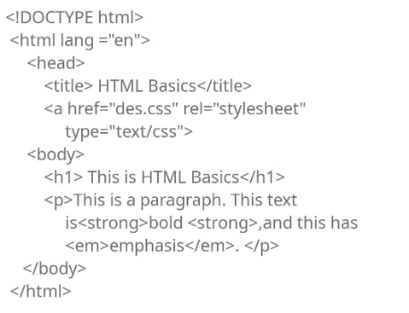
DOCUMENT STRUCTURE
The basic HTML structure consists of the , and tags. The tag contains the entire HTML document, while the tags include meta information about the document, such as its title and links to external resources. The tag encloses the content visible to the users.

Slide 10

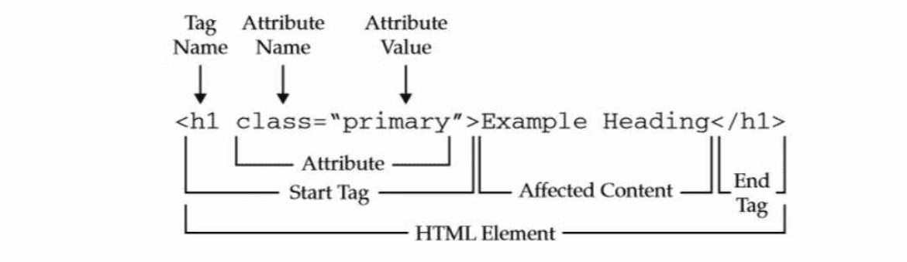
ELEMENT SYNTAX
HTML element consists of a start tag, content and an end tag. The start tag denotes the beginning of an element, and the end tag denotes the end. Elements can also have attributes which provide additional information about the element.

Slide 11
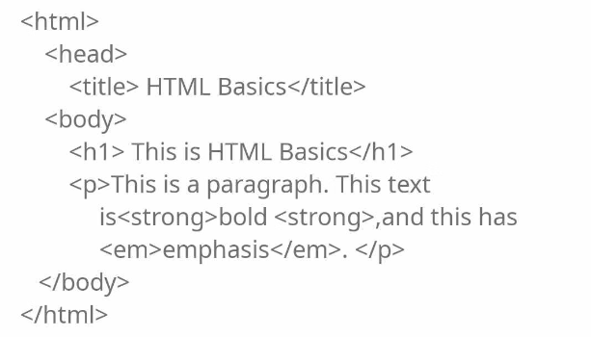
NESTING ELEMENT
In HTML, elements can be nested within one another. This means that elements can contain other elements creating hierarchical structure for organisizing content. Proper nesting is essential for creating well structured and semantically meaningful HTML document

Slide 12
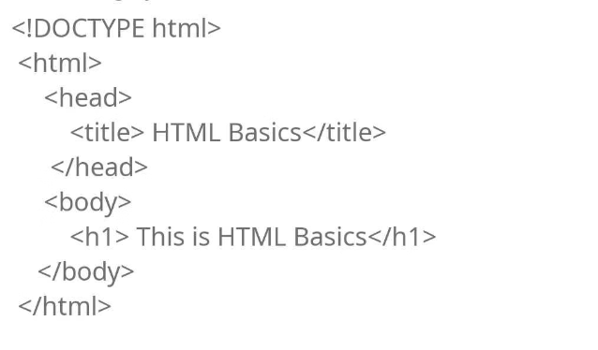
DOCTYPE DECLARATION
Every HTML document should begin with a declaration, which specifies the version of HTML being used. This declaration helps browsers render the page correctly and ensures compatibility across different web browsers.

Slide 13
HTML TAGS AND ELEMENTS
HTML TAGS
ELEMENTS ATTRIBUTES
SEMANTIC ELEMENTS
These are the building blocks of an HTML document. They define the structure, content, layout, of the web page. Tags like <div> , <p> , <h1> and <img> are essential for creating a well structured webpage.
Attributes provide additional information about HTML elements. They can modify the elements behavior or provide metadata. Attributes like href, src, alt and style are used to enhance the functionality and appearance of an element
These are HTML5 elements that add meaning to the content. examples include the <header> , <footer>, <article>and <section> they help define the structure of a webpage beyond just presentations

Slide 14
HTML TAGS AND ELEMENTS
<html> This tag represents the root of an html document and contains all other elements
<head> This tag contains meta-information about the html document, such as the title, stylesheets, and scripts
<body> This tag contains the visible content of the HTML document including text, images, links and other elements
<h1 to <h6> These tags represents headings of different levels, with <h1> being the highest levels and <h6> being the lowest
<p> This tag is used to define the paragraph of a text.

Slide 15
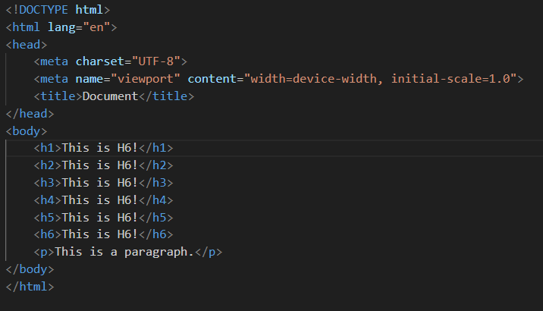
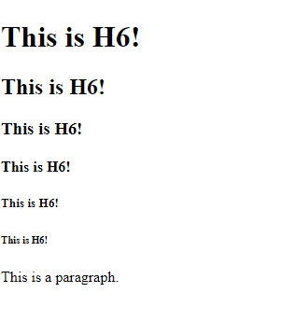
HTML TAGS AND ELEMENTS

Slide 16
HTML TAGS AND ELEMENTS
<a> This tag creates a hyperlink to another webpage or a specific location within the same page.
<img> This tag is used to insert an image into the HTML document
<ul> and <li> These tags are used to create unordered list. <ul> represents the list container, and <li> represents each last item.
<ol> and <li> These tags are used to create ordered lists. <ol> represents the list container and <li> represents each last item.
<div> This tag is a generic container that can be used to group and style other elements

Slide 17

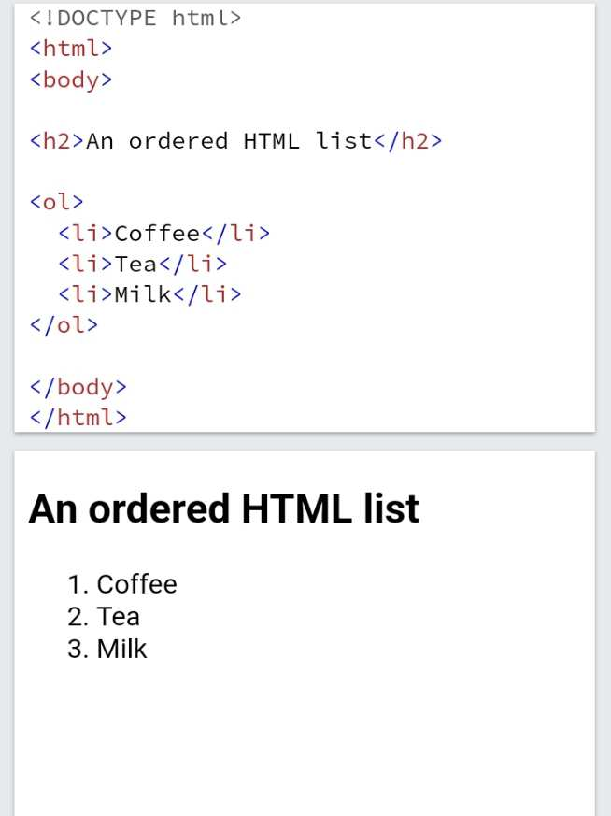
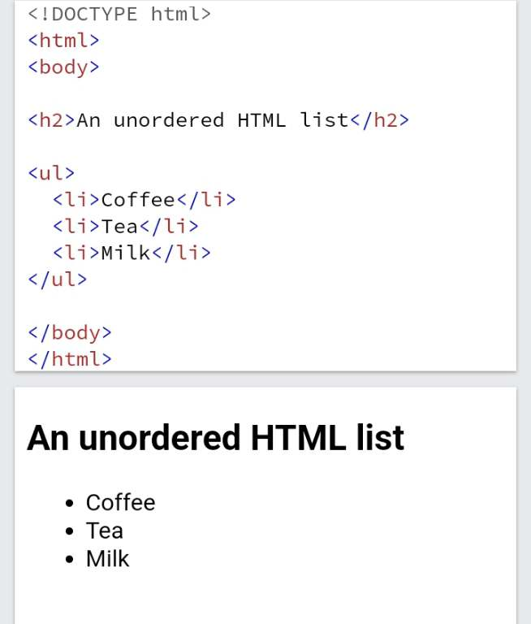
Example of Ordered List
Example of Unordered List

Slide 18
HTML TAGS AND ELEMENTS
<span> This tag is similar to <div> but it is an inline element and is often used to apply styles to a specific section of text.
<table> , <tr>, <td> These tags are used to create tables. <table> represents the table itself, <tr> represents a table row, and <td> represents a table cell.
<form>, <input>, <button> These tags are used to create forms for user input. <form> represents the form container, <input> represents various input fields (text, checkbox, radio,etc.) and <button> represents clickable button.
title> elements specifies a title for the HTML page (which is shown in browser's title bar or in the page's tab)

Slide 19
ELEMENT ATTRIBUTES
ALL HTML ELEMENTS CAN HAVE ATTRIBUTES.
1
2
ATTRIBUTES PROVIDE ADDITIONAL INFORMATION ABOUT ELEMENT
ATTRIBUTES ARE ALWAYS SPECIFIED IN THE START TAG
3
4
ATTRIBUTES USUALLY COME IN NAME/VALUE PAIRS LIKE: name="value"

Slide 20
The href Attribute
The <a> tag defines a hyperlink. The href attribute specifies the URL of the page the link goes to:
example
<a href="https://www.facebook.com">Visit Us</a>

Slide 21
The src Attribute
The tag is used to embed an image in an HTML page. The src attribute specifies the path to the image to be displayed: The tag should also contain the width and height attributes, which specify the width and height of the image (in pixels): The required alt attribute for the tag specifies an alternate text for an image, if the image for some reason cannot be displayed. This can be due to a slow connection, or an error in the src attribute, or if the user uses a screen reader.
example
<img src="img_girl.jpg">
<img src="img_girl.jpg" width="500" height="600">
<img src="img_girl.jpg" alt=Girl with a jacket">

Slide 22
Semantic Elements in Html
A semantic element clearly describes its meaning to both the browser and the developer
Examples of semantic elements: <form>, <table>, and <article> - Clearly defines its content
Many web sites contain HTML code like: <div id="nav"> <div class="header"> <div id="footer"> to indicate navigation, header, and footer
In HTML there are some semantic elements that can be used to define different parts of a web page:

Slide 23
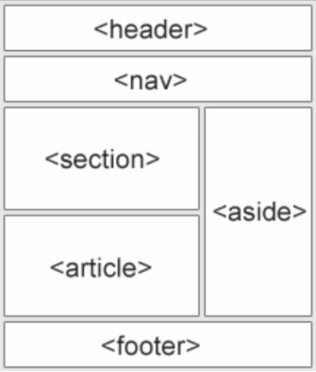
<article> <main>
<aside> <mark>
<details> <nav>
<figcaption> <section>
<figure> <summary>
<footer> <time>
<header>

Slide 24
<article> The <article> element specifies independent, self-contained content.
<aside> The <aside> element defines some content aside from the content it is placed in (like a sidebar).
<details> Defines additional details that the user can view or hide
<figcaption> The <figcaption> tag defines a caption for a <figure> element. The <figcaption> element can be placed as the first or as the last child of a <figure> element.
<figure> The <figure> tag specifies self-contained content, like illustrations, diagrams, photos, code listings, etc.
<footer> The <footer> element defines a footer for a document or a section.

Slide 25
<header> The <header> element represents a container for introductory content or a set of navigational links.
<main> Specifies the main content of a document
<mark> Defines marked/highlighted text
<nav> The <nav> element defines a set of navigation links
<section> The <section> element defines a section in a document.
<summary> Defines a visible heading for a <details> element
<time> Defines a date/time

Slide 26
CONCLUSION
In conclusion, HTML (Hypertext Markup Language) serves as the backbone of web development, providing a standardized structure and framework for creating and designing web pages. By utilizing various elements like text, links, images, lists, tables, forms, multimedia, and semantic elements, developers can create visually appealing and interactive websites accessible across different devices and platforms. HTML, combined with CSS for styling and JavaScript for interactivity, forms the foundation of modern web development, enabling the creation of dynamic and engaging online experiences for users worldwide.

